Slide 1

Open Licenses for Data, Code and Software for Data Stewards
Pilot Train-the-Trainer Course
June 19, 2024

Slide 2
Course Authors and Instructor
Lorna Wildgaard, Royal Library, Copenhagen University Library, Denmark (lowi@kb.dk) - author
Benjamin Derksen, Royal Library, Copenhagen University Library, Denmark (bder@kb.dk) - author
Agnes Jasinska, Digital Curation Centre, University of Edinburgh, UK (agnes.jasinska@ed.ac.uk) - instructor
Open Licenses for Data, Code, and Software Pilot – CC-BY SA – 19.06.2024

Slide 3
Learning objectives
After completing this training, you will be able to:
Explain the different types of licenses for FAIR (Findable, Accessible, Interoperable, Reusable) research outputs, including both research data and research software.
Apply appropriate licenses when sharing research outputs.
Argue for the choice of appropriate licenses to research output and for the importance of creating machine-readable licenses.
Engage in the research process and influence it to accommodate for FAIR data and software.
Open Licenses for Data, Code, and Software Pilot – CC-BY SA – 19.06.2024

Slide 4
Outline
Welcome!
Unit 1: Why you should license research outputs (and how to address concerns)
Activity 1: Arguments for (open) licensing of research outputs
Unit 2: Before you apply a license to a research output
Activity 2: Factors to consider when selecting a license
Break
Unit 3: Selecting and applying (open) licenses in real life
Activity 3: Selecting a license
Wrapping up and evaluation
Open Licenses for Data, Code, and Software Pilot – CC-BY SA – 19.06.2024

Slide 5
A quick poll
Do you work with research data? Research code/software? Both research data and research code/software?
Which country do you work in?
Open Licenses for Data, Code, and Software Pilot – CC-BY SA – 19.06.2024

Slide 6

Ice-breaker (in small groups)
Join the breakout room (it will open in a new browser window; please keep it open after the ice-breaker – we will reuse it)
Take turns to introduce yourself (in 30 seconds or so)
Your name
Your organization
Your research area
Open Licenses for Data, Code, and Software Pilot – CC-BY SA – 19.06.2024

Slide 7
Unit 1: Why you should license your research output (and how to overcome resistance)
Open Licenses for Data, Code, and Software Pilot – CC-BY SA – 19.06.2024

Slide 8
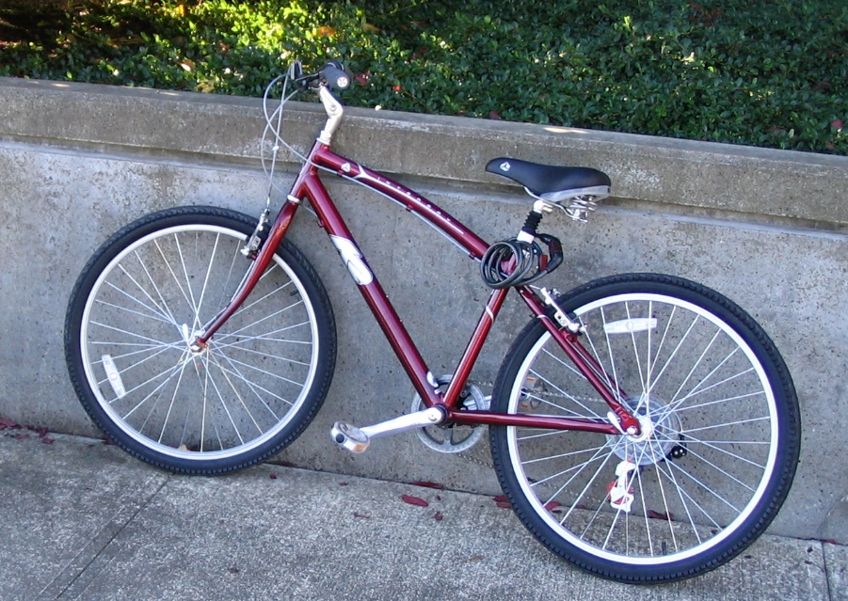
Why license your research output?
Image from Flickr, licensed CC0 (https://flic.kr/p/6kHZ9r)
Open Licenses for Data, Code, and Software Pilot – CC-BY SA – 19.06.2024
Notes:
Imagine that you are walking in the city and you see a bicycle propped against a wall. It’s a very nice bicycle. You would love to take it. It’s exactly what you need. You could make good use of it. But… you’re not sure if you can. Why did the owner leave it here? There is no one around you could ask. What if you take the bicycle and get in trouble? You don’t want to take the risk. So you leave the bicycle and you walk away.

Slide 9
Why license your research output?
FREE
to a good home
Image from Flickr, licensed CC0 (https://flic.kr/p/6kHZ9r)
Open Licenses for Data, Code, and Software Pilot – CC-BY SA – 19.06.2024

Slide 10
Why license your research output?
FREE
to a good home
A license is a clear invitation for others to REUSE your research data or software – on your terms.
Image from Flickr, licensed CC0 (https://flic.kr/p/6kHZ9r)
Open Licenses for Data, Code, and Software Pilot – CC-BY SA – 19.06.2024

Slide 11

Why license your research output?
FAIR principles for research data → R1.1. (meta)data are released with a clear and accessible data usage license.
FAIR principles for research software → R1.1. Software is given a clear and accessible license.
Sources : 1 - 2 - 3 - 4
Open Licenses for Data, Code, and Software Pilot – CC-BY SA – 19.06.2024

Slide 12
So why doesn’t everyone license their research outputs? What are some common reasons?
Add your thoughts to the chat and let’s discuss!
Open Licenses for Data, Code, and Software Pilot – CC-BY SA – 19.06.2024

Slide 13


How to address concerns and advocate for licensing
What is licensing, anyway? It’s not relevant to research.
Most countries have intellectual property rights that protect creative work, including research outputs. Licensing is a legal tool to share research.
Sources : 1 - 2 - 3 - 4 - 5
image source - Pixabay CC0
Open Licenses for Data, Code, and Software Pilot – CC-BY SA – 19.06.2024

Slide 14
How to address concerns and advocate for licensing
What is licensing, anyway? It’s not relevant to research.
Most countries have intellectual property rights that protect creative work, including research outputs. Licensing is a legal tool to share research.
My data doesn’t need to be shared. Only my papers.
A lot of research is publicly funded, and applying an open license to your research outputs helps to maximize the benefits of that research to society.
Sources : 1 - 2 - 3 - 4 - 5
image source - Pixabay CC0
Open Licenses for Data, Code, and Software Pilot – CC-BY SA – 19.06.2024

Slide 15
How to address concerns and advocate for licensing
What is licensing, anyway? It’s not relevant to research.
Most countries have intellectual property rights that protect creative work, including research outputs. Licensing is a legal tool to share research.
My data doesn’t need to be shared. Only my papers.
A lot of research is publicly funded, and applying an open license to your research outputs helps to maximize the benefits of that research to society.
If somebody misuses my data, I will be blamed.
A limitations and disclaimers clause in a license clearly states that the research data is shared ‘as is’ and the original researcher is not responsible for the outcomes of reuse.
Sources : 1 - 2 - 3 - 4 - 5
image source - Pixabay CC0
Open Licenses for Data, Code, and Software Pilot – CC-BY SA – 19.06.2024

Slide 16
How to address concerns and advocate for licensing
What is licensing, anyway? It’s not relevant to research.
Most countries have intellectual property rights that protect creative work, including research outputs. Licensing is a legal tool to share research.
My data doesn’t need to be shared. Only my papers.
A lot of research is publicly funded, and applying an open license to your research outputs helps to maximize the benefits of that research to society.
If somebody misuses my data, I will be blamed.
A limitations and disclaimers clause in a license clearly states that the research data is shared ‘as is’ and the original researcher is not responsible for the outcomes of reuse.
Many researchers worry that they can be liable for reuse (or misuse) of their data. For example, if construction-related research data is reused to build a building that later collapsed, could the researcher be liable?
With an appropriate (open) license, you protect yourself from unpleasant situations and also maximize the benefits of your research.
Sources : 1 - 2 - 3 - 4 - 5
image source - Pixabay CC0
Open Licenses for Data, Code, and Software Pilot – CC-BY SA – 19.06.2024

Slide 17
How to address concerns and advocate for licensing
Data is still usable to others without a license, so why bother?
Releasing data without a license (i.e., without making the terms of use clear) can be confusing and counterproductive. It deters potential users.
Sources : 1 - 2 - 3 - 4 - 5
image source - Pixabay CC0
Open Licenses for Data, Code, and Software Pilot – CC-BY SA – 19.06.2024

Slide 18
How to address concerns and advocate for licensing
Data is still usable to others without a license, so why bother?
Releasing data without a license (i.e., without making the terms of use clear) can be confusing and counterproductive. It deters potential users.
Nobody’s data gets reused anyway, and if it is, they don’t get credit. There’s no benefit.
‘
Data is a valuable research output. By applying a license, you can ensure you get the credit for it.
Sources : 1 - 2 - 3 - 4 - 5
image source - Pixabay CC0
Open Licenses for Data, Code, and Software Pilot – CC-BY SA – 19.06.2024

Slide 19
How to address concerns and advocate for licensing
Data is still usable to others without a license, so why bother?
Releasing data without a license (i.e., without making the terms of use clear) can be confusing and counterproductive. It deters potential users.
Nobody’s data gets reused anyway, and if it is, they don’t get credit. There’s no benefit.
‘
Data is a valuable research output. By applying a license, you can ensure you get the credit for it.
My collaborators think I’m making things way too complicated by licensing data.
Choosing a license can be straightforward. Your institution may have a licensing policy. Or use tools like choosealicense.com to go through the process.
Sources : 1 - 2 - 3 - 4 - 5
image source - Pixabay CC0
Open Licenses for Data, Code, and Software Pilot – CC-BY SA – 19.06.2024

Slide 20
How to address concerns and advocate for licensing
Data is still usable to others without a license, so why bother?
Releasing data without a license (i.e., without making the terms of use clear) can be confusing and counterproductive. It deters potential users.
Nobody’s data gets reused anyway, and if it is, they don’t get credit. There’s no benefit.
‘
Data is a valuable research output. By applying a license, you can ensure you get the credit for it.
My collaborators think I’m making things way too complicated by licensing data.
Choosing a license can be straightforward. Your institution may have a licensing policy. Or use tools like choosealicense.com to go through the process.
Licensing data can be intimidating. There are many licenses available, and choosing and applying them seems complicated. Also, the benefit to researchers is not always clear.
Licensing is a key aspect of Open Science. By applying (open) licenses, you remove any ambiguity over how others can reuse your research outputs.
Sources : 1 - 2 - 3 - 4 - 5
image source - Pixabay CC0
Open Licenses for Data, Code, and Software Pilot – CC-BY SA – 19.06.2024

Slide 21
Learning activity 1 (in small groups)
Now it’s your turn:
Discuss with your group:
How could you convince a researcher who doesn't want to use licenses?
How is licensing research data or software beneficial to them?
Based on your discussion, select 2 or 3 strongest arguments to advocate for using open licenses for research outputs – and add them to the thread in the Forum under learning activity 1.
https://learning.skills4eosc.eu/mod/forum/view.php?id=322
Open Licenses for Data, Code, and Software Pilot – CC-BY SA – 19.06.2024

Slide 22
Unit 1 Takeaways
Applying a license is critical to disseminating a research product (both data and software). Without a license, the terms of reuse are unclear and potential users may walk away.
When faced with a reluctance to use a license, emphasize that it is not a constraint but a benefit to the researcher and their scientific community (protection of one’s rights, more citations, more reuse, greater impact).
Th
Open Licenses for Data, Code, and Software Pilot – CC-BY SA – 19.06.2024

Slide 23
Unit 2: What to consider before applying licenses to research outputs
Open Licenses for Data, Code, and Software Pilot – CC-BY SA – 19.06.2024

Slide 24
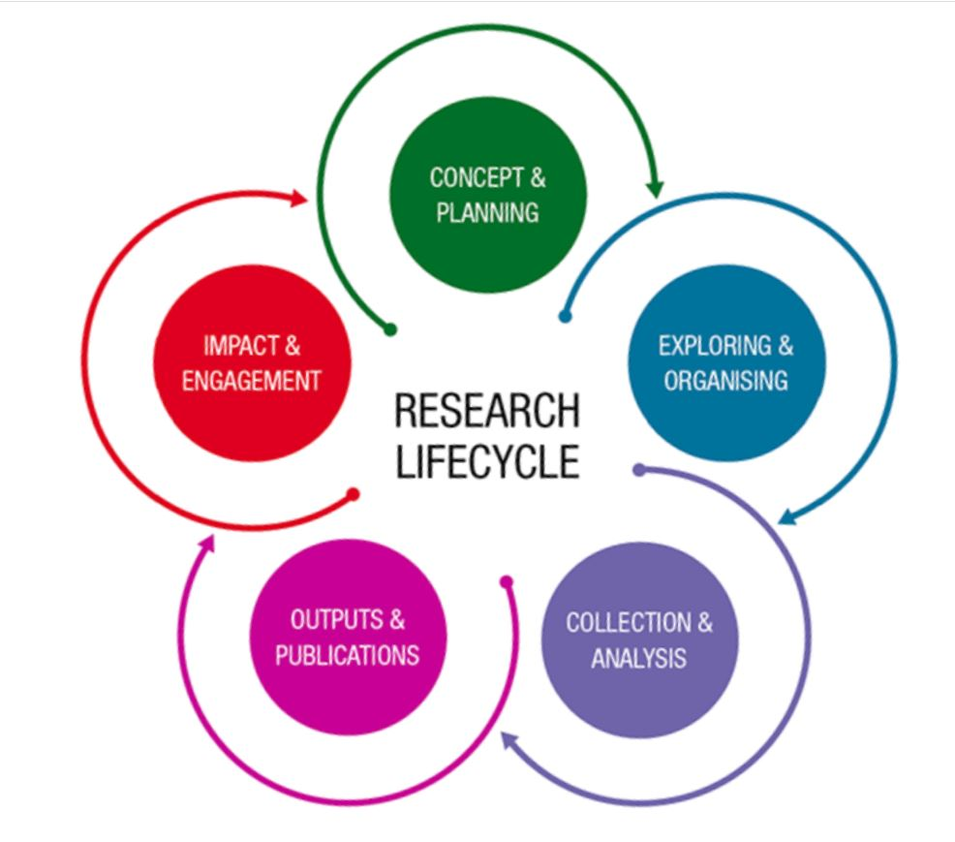
The research life cycle
Licensing is relevant at all stages in the research life cycle.
Keep it in mind from the beginning, and continue to evaluate and plan for it throughout the research project.
Source:
Monash University
Open Licenses for Data, Code, and Software Pilot – CC-BY SA – 19.06.2024

Slide 25
The goal is to make the research outputs…
…as open as possible,
as closed as necessary
Open Licenses for Data, Code, and Software Pilot – CC-BY SA – 19.06.2024

Slide 26

Checklist before sharing research & selecting a license
Right to assign a license
Funder requirements
Journal and repository requirements
Ethical concerns
Personal data
Contractual obligations
Reduced novelty of findings
Ability to commercialize
Copyright/license infringement
Dual use
Factors to assess
Illustration: janjf93
Open Licenses for Data, Code, and Software Pilot – CC-BY SA – 19.06.2024

Slide 27
Checklist before sharing research & selecting a license
Right to assign a license
Funder requirements
Journal and repository requirements
Ethical concerns
Personal data
Contractual obligations
Reduced novelty of findings
Ability to commercialize
Copyright/license infringement
Dual use
+ institutional policies
+ national laws & regulations
Factors to assess
The sum determines the ability to share and license research outputs.
Illustration: janjf93
Open Licenses for Data, Code, and Software Pilot – CC-BY SA – 19.06.2024

Slide 28
1. Assessment of... right to assign a license
LICENSE – a legal document allowing the holder of the rights in a work to grant certain rights over the use of that work to others
Open Licenses for Data, Code, and Software Pilot – CC-BY SA – 19.06.2024

Slide 29

1. Assessment of... right to assign a license
What does it look like?
Source: Wikimedia
11.5 Members of staff shall promptly notify the University of all copyright works (including computer software) and all designs (whether registered or unregistered) made, whether alone or with others, in the course of employment. Under the provisions of the Copyright, Designs and Patents Act 1988 and the Registered Designs Act 1949, as amended, the rights in such works or designs shall normally be the property of the University. In the case of the commercial exploitation of copyright works (including computer software) and designs (whether registered or unregistered) made in the course of employment, members of staff are required to consult with the University in order that appropriate arrangements are agreed. The University may not always seek to benefit from any rights in copyright works and designs which it may have as employer.
Source: University of Bristol regulations
Open Licenses for Data, Code, and Software Pilot – CC-BY SA – 19.06.2024

Slide 30
1. Assessment of... right to assign a license – cont’d
Institutional or national rules may govern your ability to share and license data and/or code. As per your employment contract, your institution may hold the rights to your research outputs.
Code and software may be subject to different regulations than data.
Open Licenses for Data, Code, and Software Pilot – CC-BY SA – 19.06.2024

Slide 31
1. Assessment of... right to assign a license – cont’d
Institutional or national rules may govern your ability to share and license data and/or code. As per your employment contract, your institution may hold the rights to your research outputs.
Code and software may be subject to different regulations than data.
Mitigation strategies for sharing research and applying a license
Investigate institutional and national rules regarding the sharing and licensing of research outputs.
Seek any permission or initiate necessary screening processes early on in the research project.
Open Licenses for Data, Code, and Software Pilot – CC-BY SA – 19.06.2024

Slide 32
2. Assessment of... funder requirements
Open Licenses for Data, Code, and Software Pilot – CC-BY SA – 19.06.2024

Slide 33
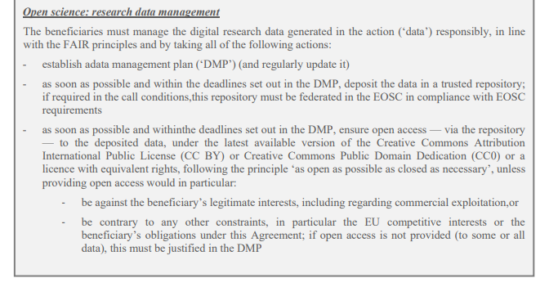
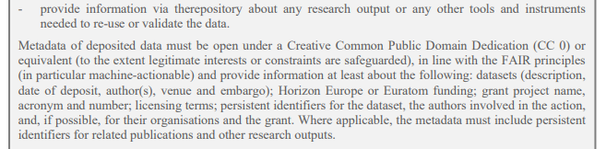
2. Assessment of... funder requirements
What does it look like?
Source: EC Annotated Grant Agreement
Open Licenses for Data, Code, and Software Pilot – CC-BY SA – 19.06.2024

Slide 34
2. Assessment of... funder requirements – cont’d
Some funders will ask you to openly share as many research outputs as possible - or to make them at least FAIR.
Some funders will ask for a detailed data management plan outlining how you will share and license research outputs.
Open Licenses for Data, Code, and Software Pilot – CC-BY SA – 19.06.2024

Slide 35
2. Assessment of... funder requirements – cont’d
Some funders will ask you to openly share as many research outputs as possible - or to make them at least FAIR.
Some funders will ask for a detailed data management plan outlining how you will share and license research outputs.
Mitigation strategies for sharing research and applying a license
Discuss the funder requirements with project partners and use a DMP to document your agreement in the preparation phase and when conducting the project.
Open Licenses for Data, Code, and Software Pilot – CC-BY SA – 19.06.2024

Slide 36
3. Assessment of... journal and repository requirements
Open Licenses for Data, Code, and Software Pilot – CC-BY SA – 19.06.2024

Slide 37
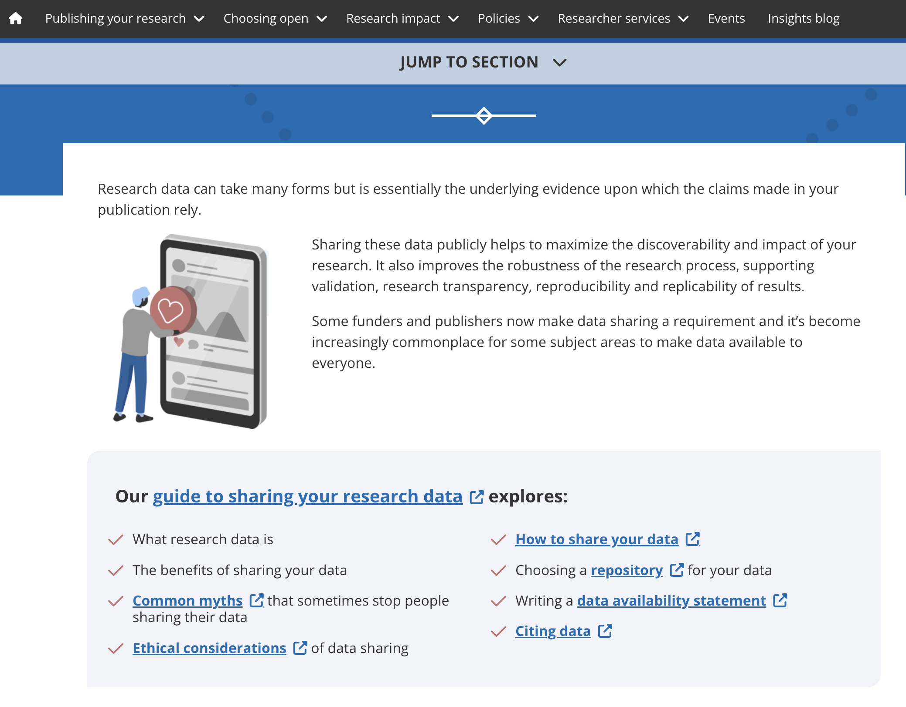
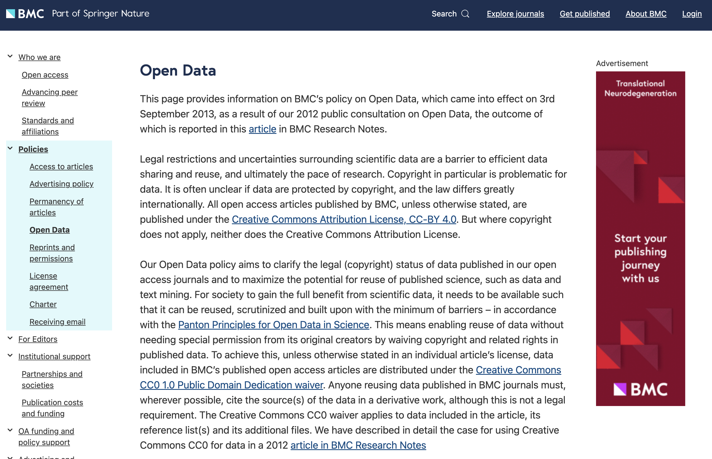
3. Assessment of... journal and repository requirements
Source: Taylor and Francis Data Policies
What does it look like?
Source: BMC on open data
Open Licenses for Data, Code, and Software Pilot – CC-BY SA – 19.06.2024

Slide 38
3. Assessment of... journal and repository requirements – cont’d
Many journals and publishers describe their expectations in policies on data availability, data sharing, or data openness.
Researchers are often asked to write a data availability statement.
Likewise, open repositories may require a specific license.
Open Licenses for Data, Code, and Software Pilot – CC-BY SA – 19.06.2024

Slide 39
3. Assessment of... journal and repository requirements – cont’d
Many journals and publishers describe their expectations in policies on data availability, data sharing, or data openness.
Researchers are often asked to write a data availability statement.
Likewise, open repositories may require a specific license.
Mitigation strategies for sharing research and applying a license
Match the journal requirements with ability to share and license, and consider publishing a subset of data, anonymise personal data, etc.
Switch publication strategy towards other journals.
Open Licenses for Data, Code, and Software Pilot – CC-BY SA – 19.06.2024

Slide 40
4. Assessment of... ethical concerns
Open Licenses for Data, Code, and Software Pilot – CC-BY SA – 19.06.2024

Slide 41
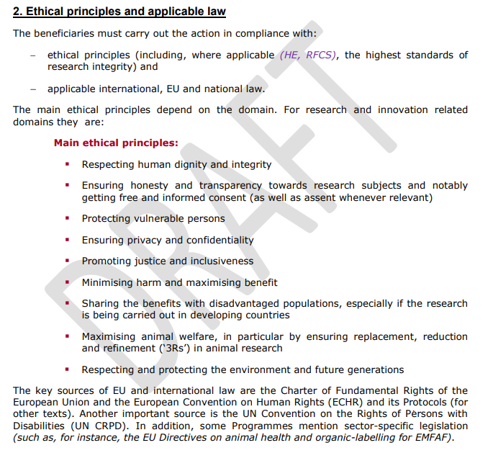
4. Assessment of... ethical concerns
What does it look like?
Source: EC Annotated Grant Agreement
Open Licenses for Data, Code, and Software Pilot – CC-BY SA – 19.06.2024

Slide 42
4. Assessment of... ethical concerns – cont’d
Funders, institutions, and journals expect ethical research conduct.
Ethical research conduct often presupposes an assessment of how the research will impact human participants, animals, plants, ecosystems, etc.
Open Licenses for Data, Code, and Software Pilot – CC-BY SA – 19.06.2024

Slide 43
4. Assessment of... ethical concerns – cont’d
Funders, institutions, and journals expect ethical research conduct.
Ethical research conduct often presupposes an assessment of how the research will impact human participants, animals, plants, ecosystems, etc.
Mitigation strategies for sharing research and applying a license
Choose a subset of the data for publication and/or de-identify data.
Obtain proper informed consent that allows for data sharing.
Open Licenses for Data, Code, and Software Pilot – CC-BY SA – 19.06.2024

Slide 44
5. Assessment of... personal data
Open Licenses for Data, Code, and Software Pilot – CC-BY SA – 19.06.2024

Slide 45
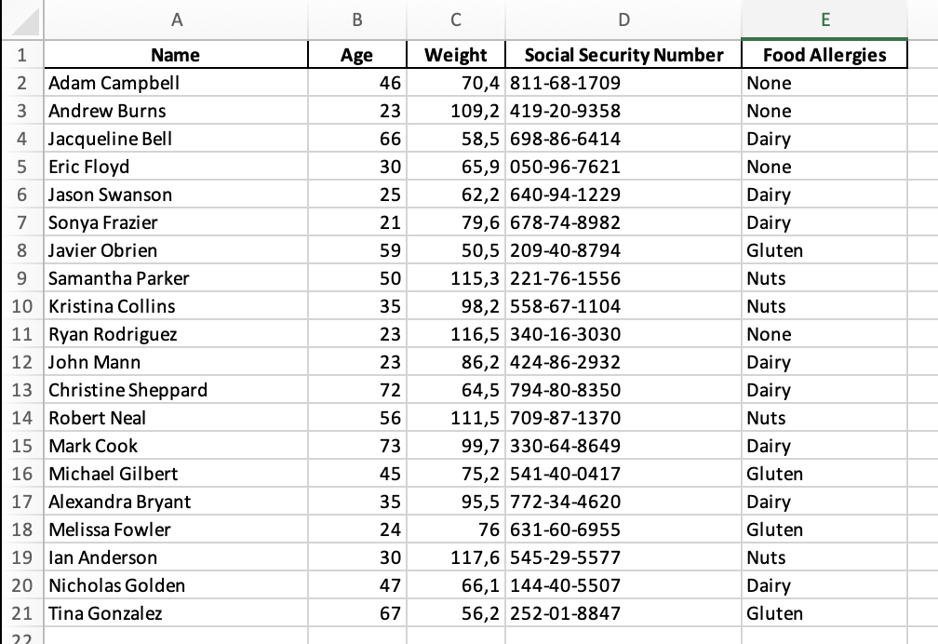

5. Assessment of... personal data
What does it look like?
Open Licenses for Data, Code, and Software Pilot – CC-BY SA – 19.06.2024

Slide 46
5. Assessment of... personal data – cont’d
General Data Protection Regulation (GDPR)
Personal data – any information related to a living person, or that can be used, directly or indirectly, to identify that person (e.g., a name, an identification number, location data, an online identifier, factors specific to the physical, physiological, genetic, mental, economic, cultural or social identity of that natural person).
https://www.legislation.gov.uk/eur/2016/679/introduction -
Open Licenses for Data, Code, and Software Pilot – CC-BY SA – 19.06.2024

Slide 47
5. Assessment of... personal data – cont’d
General Data Protection Regulation (GDPR)
Personal data – any information related to a living person, or that can be used, directly or indirectly, to identify that person (e.g., a name, an identification number, location data, an online identifier, factors specific to the physical, physiological, genetic, mental, economic, cultural or social identity of that natural person).
https://www.legislation.gov.uk/eur/2016/679/introduction -
Mitigation strategies for sharing research and applying a license
Obtain proper informed consent that allows for data sharing.
Anonymise personal data.
Consider only making metadata openly available.
Open Licenses for Data, Code, and Software Pilot – CC-BY SA – 19.06.2024

Slide 48
6. Assessment of... contractual obligations
Open Licenses for Data, Code, and Software Pilot – CC-BY SA – 19.06.2024

Slide 49
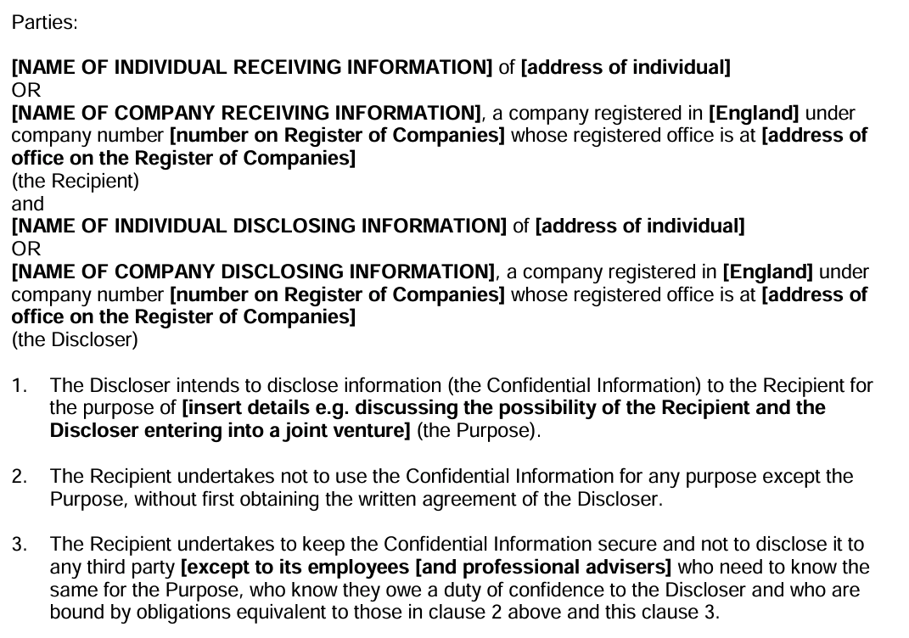
6. Assessment of... contractual obligations
What does it look like?
Source: Example of a NDA from gov.uk
Open Licenses for Data, Code, and Software Pilot – CC-BY SA – 19.06.2024

Slide 50
6. Assessment of... contractual obligations – cont’d
Some contracts, especially non-disclosure agreements (NDAs), limit your ability to make data and/code openly available or explicitly require access restrictions.
Other contracts define usage rights in a way that limits the ability to apply a license or specifies who should be attributed in the license.
Open Licenses for Data, Code, and Software Pilot – CC-BY SA – 19.06.2024

Slide 51
6. Assessment of... contractual obligations – cont’d
Some contracts, especially non-disclosure agreements (NDAs), limit your ability to make data and/code openly available or explicitly require access restrictions.
Other contracts define usage rights in a way that limits the ability to apply a license or specifies who should be attributed in the license.
Mitigation strategies for sharing research and applying a license
Revisit the agreement and create an addendum for sharing and licensing.
Consider making only a subset of the data available or applying multiple licenses with different metadata to different subsets.
Consider making only metadata openly available and define access restrictions and an agreement for data reuse.
Open Licenses for Data, Code, and Software Pilot – CC-BY SA – 19.06.2024

Slide 52
7. Assessment of... risk of reduced novelty of findings
Open Licenses for Data, Code, and Software Pilot – CC-BY SA – 19.06.2024

Slide 53
7. Assessment of... risk of reduced novelty of findings
What does it look like?
Criteria for publication
The criteria for publication of scientific papers (Articles) in Nature are that they:
report original scientific research (the main results and conclusions must not have been published or submitted elsewhere)
are of outstanding scientific importance
reach a conclusion of interest to an interdisciplinary readership.
Source: Nature Editorial Guidelines
Open Licenses for Data, Code, and Software Pilot – CC-BY SA – 19.06.2024

Slide 54
7. Assessment of... risk of reduced novelty of findings
Example of a letter from a journal to an author.
Subject: Decision on Manuscript ID [XXXXX] - [Title of Your Article]
Thank you for submitting your manuscript entitled "[Title of Your Article]" to [Journal Name]. We appreciate the opportunity to consider your work for publication. After careful evaluation by our editorial team and external reviewers, we regret to inform you that we are unable to accept your manuscript for publication in [Journal Name].
The peer review process is integral to maintaining the quality and integrity of the work published in our journal. Based on the feedback received, the primary reason for our decision is the lack of sufficient novelty in the research presented. While your study is methodologically sound, the reviewers noted that the findings do not significantly advance the current understanding in the field or offer new or compelling insights. In our commitment to publishing work that provides notable contributions and advances to the field, we must be stringent in our criteria for novelty and significance.
What does it look like?
Criteria for publication
The criteria for publication of scientific papers (Articles) in Nature are that they:
report original scientific research (the main results and conclusions must not have been published or submitted elsewhere)
are of outstanding scientific importance
reach a conclusion of interest to an interdisciplinary readership.
Source: Nature Editorial Guidelines
Open Licenses for Data, Code, and Software Pilot – CC-BY SA – 19.06.2024

Slide 55
7. Assessment of... risk of reduced novelty of findings – cont’d
Consider if making data and/or code openly available will ...
enable others to reach the same conclusions before you (scooping)?
make your related work (e.g. an article) seem less original?
Open Licenses for Data, Code, and Software Pilot – CC-BY SA – 19.06.2024

Slide 56
7. Assessment of... risk of reduced novelty of findings – cont’d
Consider if making data and/or code openly available will ...
enable others to reach the same conclusions before you (scooping)?
make your related work (e.g. an article) seem less original?
Mitigation strategies for sharing research and applying a license
Decide on the best timing of making data and/or code openly available.
Share and license only subsets of the data early in the research project.
Open Licenses for Data, Code, and Software Pilot – CC-BY SA – 19.06.2024

Slide 57
8. Assessment of... ability to commercialize
Open Licenses for Data, Code, and Software Pilot – CC-BY SA – 19.06.2024

Slide 58
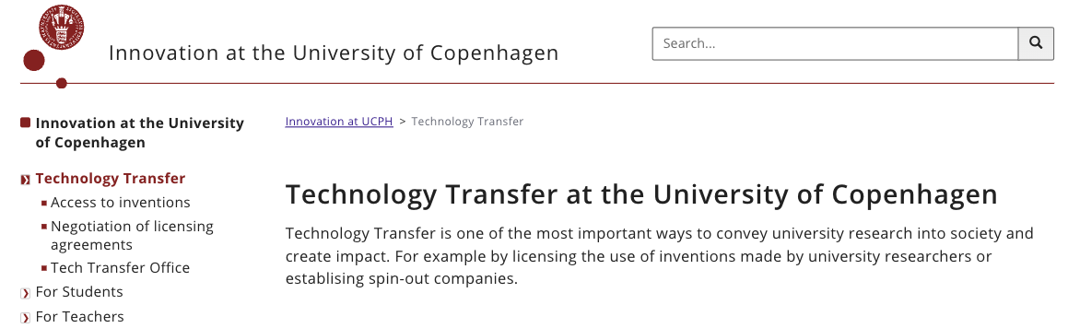
8. Assessment of... ability to commercialize
What does it look like?
Example of TTO office. Source: University of Copenhagen TTO
Open Licenses for Data, Code, and Software Pilot – CC-BY SA – 19.06.2024

Slide 59
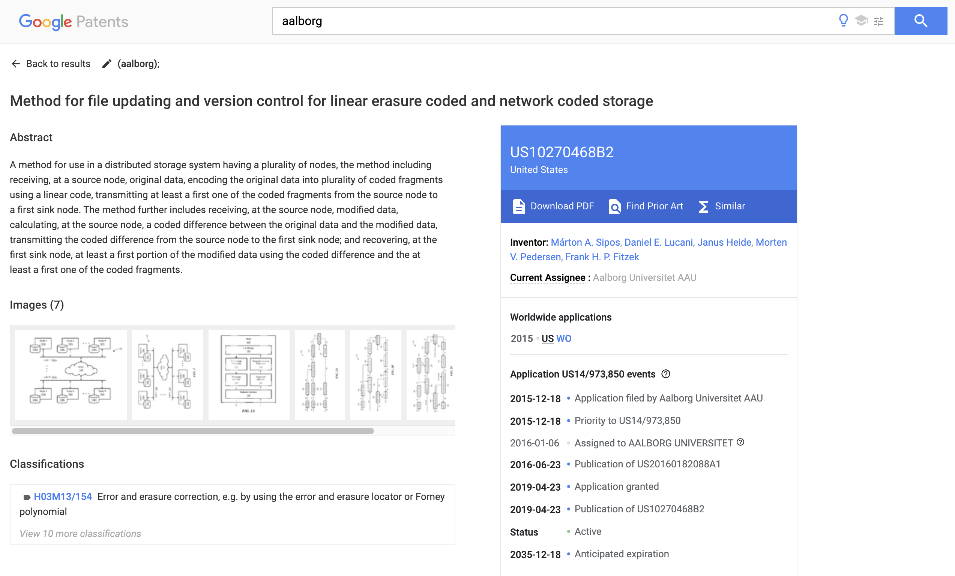
8. Assessment of... ability to commercialize – cont’d
What does it look like?
Source: Google Patents
Open Licenses for Data, Code, and Software Pilot – CC-BY SA – 19.06.2024

Slide 60
8. Assessment of... ability to commercialize – cont’d
Consider if making data and/or code openly available will...
hinder the ability to pursue a commercialization potential or obtaining a patent.
Open Licenses for Data, Code, and Software Pilot – CC-BY SA – 19.06.2024

Slide 61
8. Assessment of... ability to commercialize – cont’d
Consider if making data and/or code openly available will...
hinder the ability to pursue a commercialization potential or obtaining a patent.
Mitigation strategies for sharing research and applying a license
Consider the timing of making data and/or code available.
Seek legal advice early on to assess commercialization potential.
Open Licenses for Data, Code, and Software Pilot – CC-BY SA – 19.06.2024

Slide 62
9. Assessment of... copyright infringement
Open Licenses for Data, Code, and Software Pilot – CC-BY SA – 19.06.2024

Slide 63
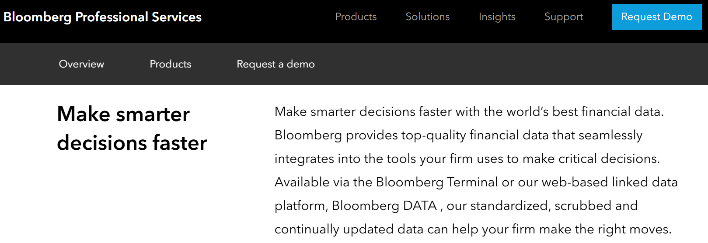
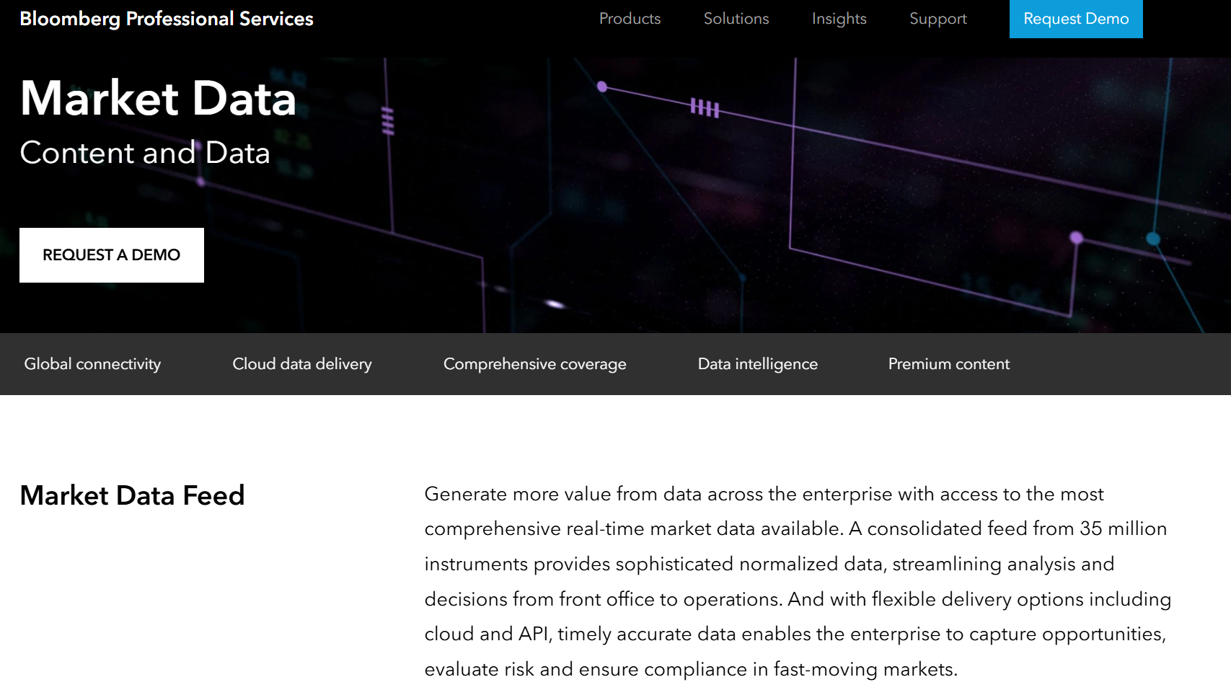
9. Assessment of... copyright infringement
What does it look like?
https://www.bloombergindustry.com/copyright-and-usage-guidelines-copyright/
Open Licenses for Data, Code, and Software Pilot – CC-BY SA – 19.06.2024

Slide 64
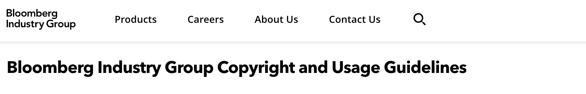
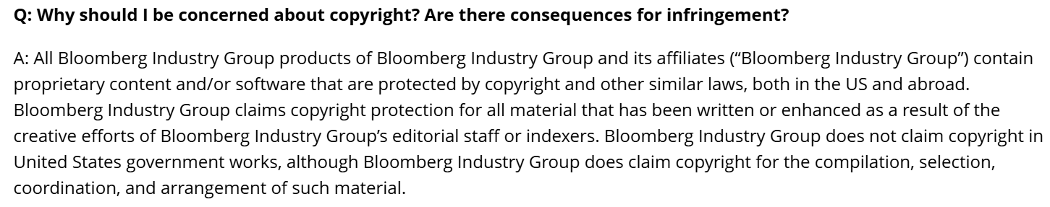
9. Assessment of... copyright infringement
What does it look like?
https://www.bloombergindustry.com/copyright-and-usage-guidelines-copyright/
Open Licenses for Data, Code, and Software Pilot – CC-BY SA – 19.06.2024

Slide 65
9. Assessment of... copyright infringement – cont’d
Some data is protected by copyright, so you cannot share or license it.
Similarly, a restrictive license will prevent most forms of reuse and sharing.
Open Licenses for Data, Code, and Software Pilot – CC-BY SA – 19.06.2024

Slide 66
9. Assessment of... copyright infringement – cont’d
Some data is protected by copyright, so you cannot share or license it.
Similarly, a restrictive license will prevent most forms of reuse and sharing.
Mitigation strategies for sharing research and applying a license
If you have the rights to do so, divide the dataset into smaller subsets that can be shared and licensed.
Utilize license stacking to combine licenses (especially relevant for code).
If you cannot share the data, share and license the detailed protocol of how you created the data.
Open Licenses for Data, Code, and Software Pilot – CC-BY SA – 19.06.2024

Slide 67
10. Assessment of... dual use

Slide 68
10. Assessment of... dual use
What does it look like?
The following topics are examples of research that could trigger dual-use export controls:
— changing the host spectrum of Lumpy skin disease virus to include human reservoirs;
— multispectral imaging camera sensors for data collection of crops;
— laser-based next-generation uranium enrichment technology as a potential alternative for the industrial enrichment that involves gaseous uranium in centrifuges;
— 3D printing of energetic materials;
— prototype drone with spraying system for combatting Eastern equine encephalitis virus;
— autonomous scientific underwater vessel that collects data automatically in deep sea regions
Source: COMMISSION RECOMMENDATION (EU) 2021/1700 of 15 September 2021 on internal compliance programmes for controls of research involving dual-use items

Slide 69
10. Assessment of... dual use – cont’d
Especially around sharing and licensing code and/or software:
“Research organisations are often concerned about the public perception of research with military potential. ‘Dual-use’ in the context of research is often considered in a broad sense: what are the (un)desired civil and military applications of research, or what is potential misuse of research for unethical purposes.”
Source: COMMISSION RECOMMENDATION (EU) 2021/1700 of 15 September 2021
Open Licenses for Data, Code, and Software Pilot – CC-BY SA – 19.06.2024

Slide 70
10. Assessment of... dual use – cont’d
Especially around sharing and licensing code and/or software:
“Research organisations are often concerned about the public perception of research with military potential. ‘Dual-use’ in the context of research is often considered in a broad sense: what are the (un)desired civil and military applications of research, or what is potential misuse of research for unethical purposes.”
Source: COMMISSION RECOMMENDATION (EU) 2021/1700 of 15 September 2021
Mitigation strategies for sharing research and applying a license
Seek legal advice in your organization, especially if you work in areas characterized by dual use.
Open Licenses for Data, Code, and Software Pilot – CC-BY SA – 19.06.2024

Slide 71
Checklist before sharing research & selecting a license
Right to assign a license
Funder requirements
Journal and repository requirements
Ethical concerns
Personal data
Contractual obligations
Reduced novelty of findings
Ability to commercialize
Copyright/license infringement
Dual use
+ institutional policies
+ national laws & regulations
Factors to assess
The sum determines the ability to share and license research outputs.
Illustration: janjf93
Open Licenses for Data, Code, and Software Pilot – CC-BY SA – 19.06.2024

Slide 72
Learning activity 2: The case of NextBox
Assessment framework
Right to assign a license
Funder requirements
Journal and repository requirements
Ethical concerns
Personal data
Contractual obligations
Reduced novelty of findings
Ability to commercialize
Copyright infringement
Dual use
What are the institutional and national regulations?
A researcher from the international project ‘NextBox’ funded by Horizon Europe with both commercial and non-commercial partners approach you to discuss dissemination of data and code from their project. The main finding is a new algorithmic approach to profile employees based on their task completion strategies. There is data and code. The paper with the results is in peer review at a journal. The DMP is filled with broad, vague intentions of sharing everything.
The data comprises 50 transcribed interviews, anonymised survey responses from the public, and partly confidential results from internal design sprints at an industry partner. Some analysis is done by combining existing openly available data, data from three proprietary sources, and internal company data.
The PI wants your advice on how to share and license the research outputs from the project.
Open Licenses for Data, Code, and Software Pilot – CC-BY SA – 19.06.2024

Slide 73
Learning activity 2: The case of NextBox
Logistics
In your small group, read the case together. Then consider the main factors that affect the choice of license and to use the appropriate mitigation strategies.
What advice would you give to the PI? Discuss with your group.
You do not need to write anything in the forum during the class – this learning activity will serve as your MAIN HOMEWORK ASSIGNMENT.
You have until the 26th of June to individually post your advice in the forum.
After you have posted your advice you will be able to read how others have advised the PI, offer comments, and continue the discussion.
https://learning.skills4eosc.eu/mod/forum/view.php?id=218 (or navigate to learning activity 2 on the Skills4EOSC site)
Notes:
Put the link to the learning activity in the Forum in the chat: https://learning.skills4eosc.eu/mod/forum/view.php?id=218&forceview=1

Slide 74
Unit 2 takeaways
Before applying licenses to research outputs, you have to balance many different factors like stakeholder requirements, ethical or legal obligations, policies, and rights.
Mitigation strategies can help you navigate the contradicting requirements, to be able to share and license research outputs.
Be aware of the benefits and risks of one license over another.
Open Licenses for Data, Code, and Software Pilot – CC-BY SA – 19.06.2024

Slide 75
5 minute break
Open Licenses for Data, Code, and Software Pilot – CC-BY SA – 19.06.2024

Slide 76
Unit 3: How to apply licences to research outputs
Open Licenses for Data, Code, and Software Pilot – CC-BY SA – 19.06.2024

Slide 77
















Overview of available open licenses
There are numerous licenses, some of which can be customized to meet specific needs, while others are highly specific.
Open Gouvernement license for public sector information
Etalab license
SPDX Licenses list
European Union Public Licence
Eclipse Public Licence
Italian Open Data License
Open Licenses for Data, Code, and Software Pilot – CC-BY SA – 19.06.2024

Slide 78
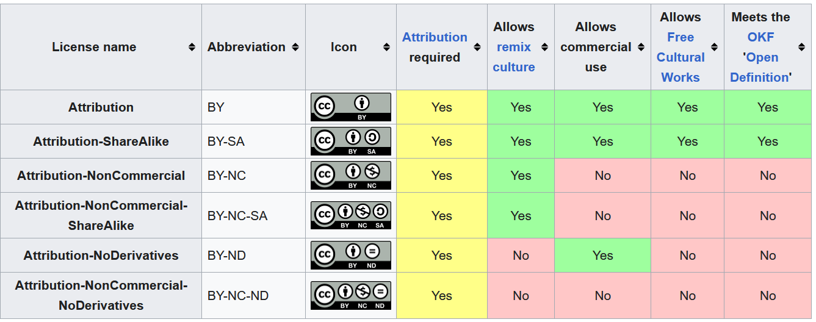
Creative Commons (CC) licenses
CC-BY license – enables reusers to copy, distribute, remix, adapt, and build upon the material in any medium or format, as long as attribution is given to the creator. Allows for commercial use.
Table from Creative Commons license Wikipage (2023, December 15) in Wikipedia. CC-BY SA 4.0. / cropped.
Open Licenses for Data, Code, and Software Pilot – CC-BY SA – 19.06.2024

Slide 79
Creative Commons (CC) licenses
CC-BY SA license – enables reusers to copy, distribute, remix, adapt, and build upon the material in any medium or format. Allows for commercial use. But you must credit the creator and you must license the modified material under identical terms.
Table from Creative Commons license Wikipage (2023, December 15) in Wikipedia. CC-BY SA 4.0. / cropped.
Open Licenses for Data, Code, and Software Pilot – CC-BY SA – 19.06.2024

Slide 80
Creative Commons (CC) licenses
For non-commercial purposes ONLY
You can copy and distribute, but NOT remix or adapt
Table from Creative Commons license Wikipage (2023, December 15) in Wikipedia. CC-BY SA 4.0. / cropped.
Open Licenses for Data, Code, and Software Pilot – CC-BY SA – 19.06.2024

Slide 81
Creative Commons (CC) licenses
Table from Creative Commons license Wikipage (2023, December 15) in Wikipedia. CC-BY SA 4.0. / cropped.
Open Licenses for Data, Code, and Software Pilot – CC-BY SA – 19.06.2024

Slide 82
Creative Commons (CC) licenses
Most open
/ permissive
Least open
/ permissive
Table from Creative Commons license Wikipage (2023, December 15) in Wikipedia. CC-BY SA 4.0. / cropped.
Open Licenses for Data, Code, and Software Pilot – CC-BY SA – 19.06.2024

Slide 83
Creative Commons (CC) licenses
Table from Creative Commons license Wikipage (2023, December 15) in Wikipedia. CC-BY SA 4.0. / cropped.
A fact sheet on Creative Commons and Open Science. Creative Commons UK, 2017. CC-BY:
https://www.fosteropenscience.eu/content/fact-sheet-creative-commons-open-science -
Open Licenses for Data, Code, and Software Pilot – CC-BY SA – 19.06.2024

Slide 84
Creative Commons (CC) zero license and public domain
LICENSE – you, the holder of the rights in a work, grant certain rights over the use of that work to others (but you still keep some rights)
WAIVER – you, the holder of the rights in a work, give up all your rights to that work
A fact sheet on Creative Commons and Open Science. Creative Commons UK, 2017. CC-BY:
https://www.fosteropenscience.eu/content/fact-sheet-creative-commons-open-science -
Open Licenses for Data, Code, and Software Pilot – CC-BY SA – 19.06.2024

Slide 85
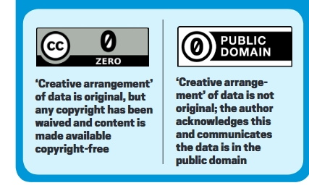
Creative Commons (CC) zero license and public domain
LICENSE – you, the holder of the rights in a work, grant certain rights over the use of that work to others (but you still keep some rights)
WAIVER – you, the holder of the rights in a work, give up all your rights to that work
CC0 / Public domain + CITATION
→ THE MOST OPEN / PERMISSIVE
A fact sheet on Creative Commons and Open Science. Creative Commons UK, 2017. CC-BY:
https://www.fosteropenscience.eu/content/fact-sheet-creative-commons-open-science -
Open Licenses for Data, Code, and Software Pilot – CC-BY SA – 19.06.2024

Slide 86
Open Data Commons Attribution License (ODC-By)
Allows to copy, distribute and use the database, to produce works from it, and to modify, transform, and build upon it for any purpose.
Good for most databases and datasets.
Data to be used for generating non-data products.
Attribution is required!
Example: Contains information from [database] which is made available under the ODC Attribution License.
Open Licenses for Data, Code, and Software Pilot – CC-BY SA – 19.06.2024

Slide 87

Open Data Commons Open Database License (ODC-ODbL)
Similar to Open Data Commons Attribution License (ODC-By) – same allowed uses, requires attribution.
Good for most databases and datasets.
Data to be used for generating non-data products.
But adds a few requirements (so less permissive)
Adds copyleft to new databases derived from the original database (derivative works must be shared on the same open terms; → ShareAlike in CC-BY SA)
Open Licenses for Data, Code, and Software Pilot – CC-BY SA – 19.06.2024

Slide 88
Open licenses for software
Open source licenses
(no copyleft)
MIT License
BSD
Apache
Software Package Data Exchange (SPDX) License List
Open Licenses for Data, Code, and Software Pilot – CC-BY SA – 19.06.2024

Slide 89
Open licenses for software
Open source licenses
(no copyleft)
MIT License
BSD
Apache
Software Package Data Exchange (SPDX) License List
Open source licenses
(low copyleft)
CeCILL
Open Licenses for Data, Code, and Software Pilot – CC-BY SA – 19.06.2024

Slide 90
Open licenses for software
Open source licenses
(no copyleft)
MIT License
BSD
Apache
Software Package Data Exchange (SPDX) License List
Open source licenses
(low copyleft)
CeCILL
Open source licenses
(copyleft)
GNU
AGPL
LGPL
Open Licenses for Data, Code, and Software Pilot – CC-BY SA – 19.06.2024

Slide 91
Open licenses for software
Open source licenses
(no copyleft)
MIT License
BSD
Apache
Software Package Data Exchange (SPDX) License List
Open source licenses
(low copyleft)
CeCILL
Open source licenses
(copyleft)
GNU
AGPL
LGPL
More open / permissive
Less open / permissive
Open Licenses for Data, Code, and Software Pilot – CC-BY SA – 19.06.2024

Slide 92
What is the appropriate license for my research output?
Refer to the copyright law in your country!
My research output is a:
data set
database
software or code
Open Licenses for Data, Code, and Software Pilot – CC-BY SA – 19.06.2024

Slide 93


What is the appropriate license for my research output?
Refer to the copyright law in your country!
My research output is a:
I can use (most popular):
data set
OSI Approved Licences
Free Software Foundation
database
software or code
Open source permissive licences (no copyleft)
Low copyleft
Open source protective licences (copyleft)
Open Licenses for Data, Code, and Software Pilot – CC-BY SA – 19.06.2024

Slide 94
Tools to help you select an open license
License selector https://ufal.github.io/public-license-selector/
Choose a license https://choosealicense.com/
Creative Commons license chooser https://chooser-beta.creativecommons.org/
Open Licenses for Data, Code, and Software Pilot – CC-BY SA – 19.06.2024

Slide 95
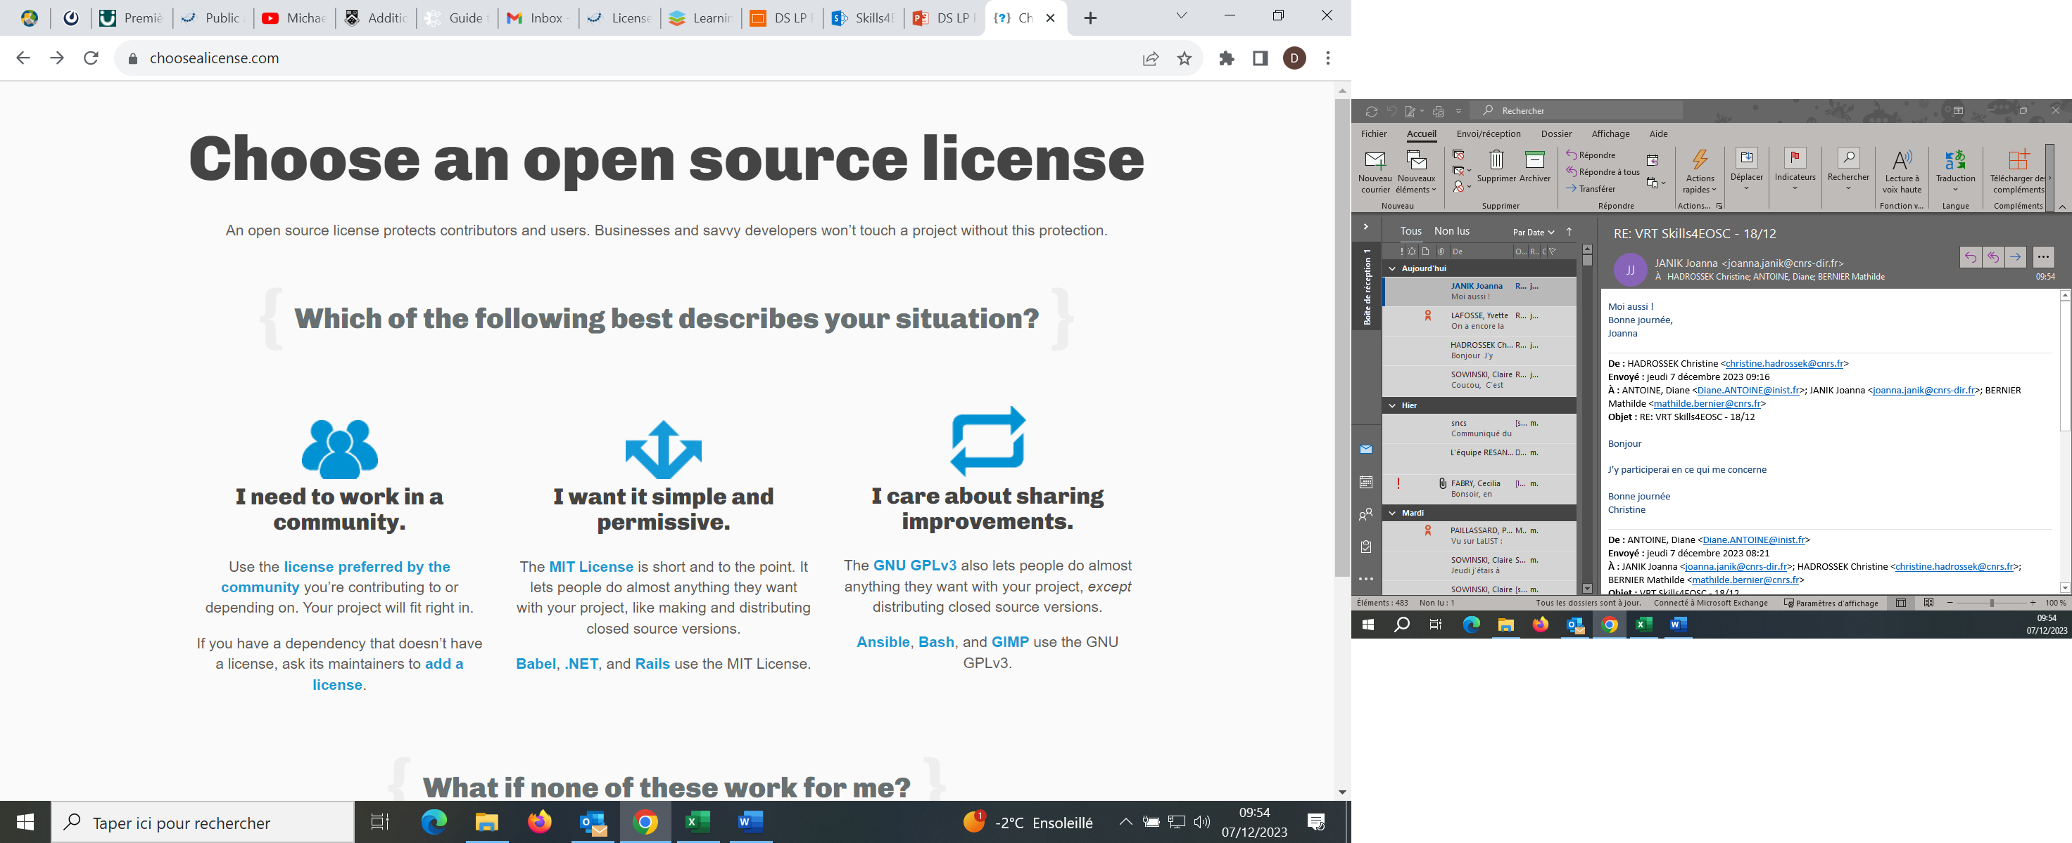
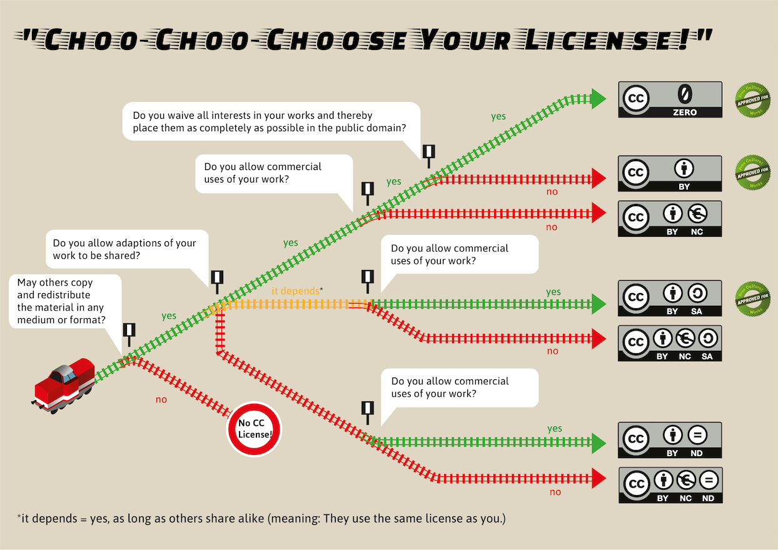
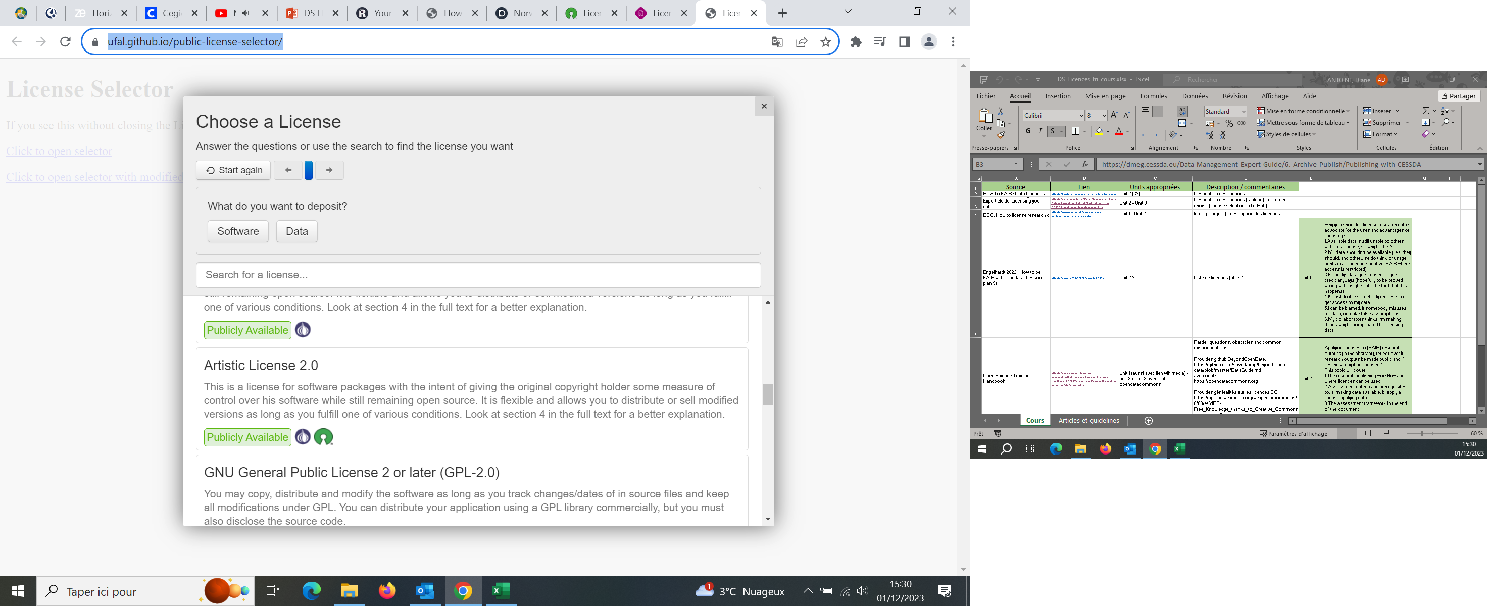
How do license-selection tools work?
How to choose your CC license
Choose a license https://choosealicense.com/
Tools to guide you to your perfect license
Source : https://commons.wikimedia.org/wiki/File:Choo-Choo_choose_your_license_(Creative_Commons_License).png CC-BY SA
EUDAT licence selector wizard https://ufal.github.io/public-license-selector/
Open Licenses for Data, Code, and Software Pilot – CC-BY SA – 19.06.2024

Slide 96
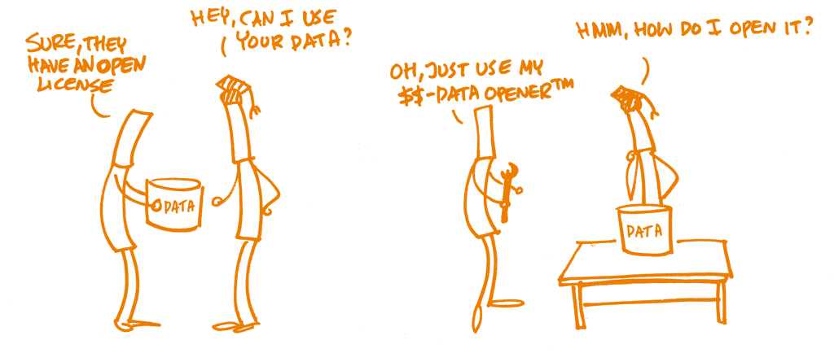

Open file format
WARNING!
If you choose an open license, but not an open file format, access might be restricted.
Image by Patrick Hochstenbach. Source: Open Science Training Handbook, https://open-science-training-handbook.github.io/Open-Science-Training-Handbook_EN/02OpenScienceBasics/06OpenLicensingAndFileFormats.html, CC0 1.0 Universal.
Open Licenses for Data, Code, and Software Pilot – CC-BY SA – 19.06.2024

Slide 97
A minute about licensing metadata
Metadata helps people discover your data.
The wider your metadata is distributed, the higher visibility of your research.
Other may want to add to it, enhance it, link to other resources – all good!
<source : https://data.europa.eu/sites/default/files/d2.1.2_training_module_2.5_data_and_metadata_licensing_en_edp.pdf CC-BY>
Open Licenses for Data, Code, and Software Pilot – CC-BY SA – 19.06.2024

Slide 98
A minute about licensing metadata
Metadata helps people discover your data.
The wider your metadata is distributed, the higher visibility of your research.
Other may want to add to it, enhance it, link to other resources – all good!
Good practices:
License the metadata as openly as possible.
A public domain license = the widest reuse.
An attribution license ensures you get credit downstream, but may cause problems if data is shared multiple times (attribution stacking).
<source : https://data.europa.eu/sites/default/files/d2.1.2_training_module_2.5_data_and_metadata_licensing_en_edp.pdf CC-BY>
Open Licenses for Data, Code, and Software Pilot – CC-BY SA – 19.06.2024

Slide 99
A minute about licensing metadata
Metadata helps people discover your data.
The wider your metadata is distributed, the higher visibility of your research.
Other may want to add to it, enhance it, link to other resources – all good!
Good practices:
License the metadata as openly as possible.
A public domain license = the widest reuse.
An attribution license ensures you get credit downstream, but may cause problems if data is shared multiple times (attribution stacking).
Which licenses are well suited for metadata?
Fully open reuse | Used but lead to attribution stacking (not ideal)
Public Domain Mark | CC-BY
CC0 | ODC-Attribution
PDDL | ISA Open Metadata licence 1.1
 | Open Government licence
<source : https://data.europa.eu/sites/default/files/d2.1.2_training_module_2.5_data_and_metadata_licensing_en_edp.pdf CC-BY>
Open Licenses for Data, Code, and Software Pilot – CC-BY SA – 19.06.2024

Slide 100
A minute about licensing metadata
Metadata helps people discover your data.
The wider your metadata is distributed, the higher visibility of your research.
Other may want to add to it, enhance it, link to other resources – all good!
Good practices:
License the metadata as openly as possible.
A public domain license = the widest reuse.
An attribution license ensures you get credit downstream, but may cause problems if data is shared multiple times (attribution stacking).
Which licenses are well suited for metadata?
Fully open reuse | Used but lead to attribution stacking (not ideal)
Public Domain Mark | CC-BY
CC0 | ODC-Attribution
PDDL | ISA Open Metadata licence 1.1
 | Open Government licence
Note: Other licenses (non-commercial, non-derivatives, share-alike) are less suited; they make reuse of metadata for Linked Data applications difficult because they place restrictions on how metadata can be shared, used and enhanced.
<source : https://data.europa.eu/sites/default/files/d2.1.2_training_module_2.5_data_and_metadata_licensing_en_edp.pdf CC-BY>
Open Licenses for Data, Code, and Software Pilot – CC-BY SA – 19.06.2024

Slide 101
A minute about machine-readable licenses
The license you apply to your research outputs should be prominently displayed, so human users can easily find it and know what terms and conditions to follow.
But the license might be first inspected by an automated tool rather than a human.
Machine-readability ensures that the automated tools can “see and understand” the license and its terms and conditions.
Note: when you upload your data or code to a repository, the machine-readability is directly handled by the repository.
<source : https://workplace.skills4eosc.eu/Products/Files/DocEditor.aspx?fileid=4543&action=view , CC-BY>
Open Licenses for Data, Code, and Software Pilot – CC-BY SA – 19.06.2024

Slide 102
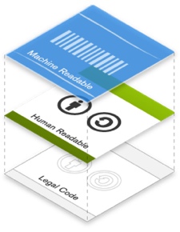
A minute about machine-readable licenses
The license you apply to your research outputs should be prominently displayed, so human users can easily find it and know what terms and conditions to follow.
But the license might be first inspected by an automated tool rather than a human.
Machine-readability ensures that the automated tools can “see and understand” the license and its terms and conditions.
Example of the Creative Commons license :
If you use the CC licence chooser tool, it generates the HTML syntax that can be copied and embedded into web pages on the Internet. This syntax would not be visible to people browsing your web pages but can be read by search engines and in this sense, CC licenses are machine-readable.
Note: when you upload your data or code to a repository, the machine-readability is directly handled by the repository.
<img and text source : https://wikieducator.org/Creative_Commons_unplugged/Anatomy_of_a_CC_license & https://wikieducator.org/File:License-layers.png CC-BY>
<source : https://workplace.skills4eosc.eu/Products/Files/DocEditor.aspx?fileid=4543&action=view , CC-BY>
Open Licenses for Data, Code, and Software Pilot – CC-BY SA – 19.06.2024

Slide 103
What if you want to reuse someone else’s research data, software, or code?
Check the license!
What kind of license is it? What are the terms and conditions under which the data, software or code are shared?
Does the license allow you to reuse the data, software or code in the way you intend?
Without a license, reusing someone else’s research outputs could lead to legal trouble.

Slide 104
Learning activity 3 (Supplementary): Choose a license
Optional homework practice that may inform your answer to Learning Activity 2.
Instructions on the Skills4EOSC course site: https://learning.skills4eosc.eu/mod/assign/view.php?id=217
Go to https://choosealicense.com/ and use the tool to help you select a possible open license for your research product.
Pay attention to the steps and the information the tool needs in the process.
Open Licenses for Data, Code, and Software Pilot – CC-BY SA – 19.06.2024

Slide 105
Unit 3 takeaways
Different research products may require different licenses, and there are many different licenses available.
You can use free online tools to find the right license for your needs.
Don’t forget to identify the rights holder (and check with them) before applying a license. Once you apply a license, you cannot take it back!
When you apply a license, make sure it is readable for both humans and machines/ automated tools (important for interoperability!)
Open Licenses for Data, Code, and Software Pilot – CC-BY SA – 19.06.2024

Slide 106
Homework and certification
Submit your homework assignment via the Skills4OESC course website (the deadline is 7 working days after this pilot course, or by the 26th of June, end of day)
Upon receipt you will receive your badge
Open Licenses for Data, Code, and Software Pilot – CC-BY SA – 19.06.2024

Slide 107
Course evaluation
Please take a few minutes to reflect on your experience in the course – and to share your feedback and suggestions on how we can improve it in the future.
Navigate to the main Skills4EOSC learning site for the course and scroll down:
https://learning.skills4eosc.eu/mod/questionnaire/view.php?id=260
Open Licenses for Data, Code, and Software Pilot – CC-BY SA – 19.06.2024

Slide 108
Works cited, further reading
Choosing a license for research data https://eprints.gla.ac.uk/171316/1/171316.pdf
Data and metadata licensing https://data.europa.eu/sites/default/files/d2.1.2_training_module_2.5_data_and_metadata_licensing_en_edp.pdf
Data management expert guide: Licensing your data https://dmeg.cessda.eu/Data-Management-Expert-Guide/6.-Archive-Publish/Publishing-with-CESSDA-archives/Licensing-your-data/
Data Packaging Guide https://github.com/saverkamp/beyond-open-data/blob/master/DataGuide.md
Fact sheet on Creative Commons and Open Science https://www.fosteropenscience.eu/content/fact-sheet-creative-commons-open-science
Open Licenses for Data, Code, and Software Pilot – CC-BY SA – 19.06.2024

Slide 109
Works cited, further reading
Foster Open Science training Handbook, chapter 6 “Open Licenses and file formats”: https://www.fosteropenscience.eu/content/open-science-training-handbook/
Graux, Hans; European Commission/Data Policy and Innovation 2023. Licence Compatibility in Europe: A winding road to Creative Commons. DOI: 10.2830/922544
Hansen, JS et al. 2021. Research Data Management Challenges in Citizen Science Projects and Recommendations for Library Support Services. A Scoping Review and Case Study. Data Science Journal, 20:25, pp. 1–29. DOI: https://doi.org/10.5334/dsj-2021-025
How to be FAIR with your data https://univerlag.uni-goettingen.de/bitstream/handle/3/isbn-978-3-86395-539-7/Engelhardt_FAIR.pdf?sequence=1&isAllowed=y
How to FAIR: chapter “Data licenses”, from: Deutz, DB et al. 2020. How to FAIR: a Danish website to guide researchers on making research data more FAIR. https://doi.org/10.5281/zenodo.3712065
Open Licenses for Data, Code, and Software Pilot – CC-BY SA – 19.06.2024

Slide 110
Works cited, further reading
How to license research data https://www.dcc.ac.uk/guidance/how-guides/license-research-data#fn18x0
License compatability in Europe : https://data.europa.eu/sites/default/files/course/Licence%20compatibility%20in%20Europe%20a%20winding%20road%20to%20Creative%20Commons_EN.pdf
RDM kit: Why should you assign a license to your research data? https://rdmkit.elixir-europe.org/licensing
The Australian Research Data Commons (ARDC) also published a guide on Rights Management that can help you choose your licence or reuse data https://ardc.edu.au/resource/research-data-rights-management-guide/
Washington State Department of Licensing: Data Stewardship https://oercommons.org/courseware/lesson/94649/overview
Open Licenses for Data, Code, and Software Pilot – CC-BY SA – 19.06.2024

Slide 111
FAIR research data and software
Wilkinson, M., Dumontier, M., Aalbersberg, I. et al. The FAIR Guiding Principles for scientific data management and stewardship. Sci Data 3, 160018 (2016). https://doi.org/10.1038/sdata.2016.18
GO FAIR Foundation: Interpreting R1.1 principle: https://www.gofair.foundation/r1-1
Barker, M., Chue Hong, N.P., Katz, D.S. et al. Introducing the FAIR Principles for research software. Sci Data 9, 622 (2022). https://doi.org/10.1038/s41597-022-01710-x
Gruenpeter, M., Granger, S., et al. (2024). D4.4 - Guidelines for recommended metadata standard for research software within EOSC (V1.0). Zenodo. https://doi.org/10.5281/zenodo.10786147
Open Licenses for Data, Code, and Software Pilot – CC-BY SA – 19.06.2024

Slide 112

Thank you! Questions?

